Slide 1
Our Heroes, Ourselves
Introduction to the Psychology, Cultural Significance and Literary Tradition of Heroes and Quest Stories

Slide 2
Your notes and handouts for this initial series of lessons will be used throughout the course.
You are creating a reference guide for your own use to apply to texts and assignments throughout the length of the class.
***KEEP EVERYTHING TOGETHER IN YOUR NOTEBOOK/BINDER***
IF YOU LOSE SOMETHING, BORROW NOTES/GET AN EXTRA COPY
***DO NOT THROW ANYTHING AWAY UNLESS OK’D BY THE TEACHER!***

Slide 3
Sigmund Freud’s Theory of Personality
Watch this video and take notes:
http://www.youtube.com/watch?v=O78LXXGQFvE https://www.youtube.com/watch?v=-i7DvpnOHlM

Slide 4
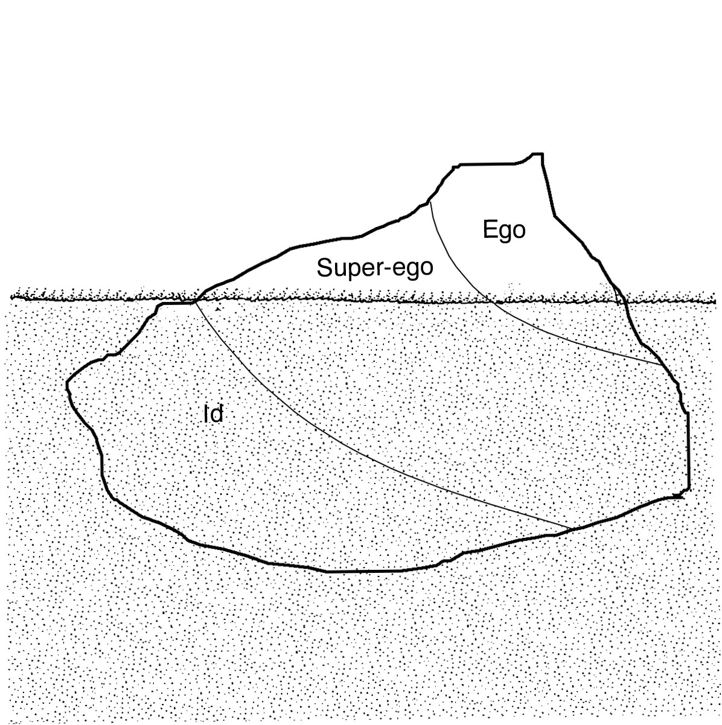
Freud’s Theory of Personality: Let’s Review…
EGO is…
Mostly Conscious
Reality Principle
What YOU think of as YOU
Mediator between Superego vs. Ego
Problem Solver
Conscious
(perceived, known, awake)
SUPEREGO is…
Mostly Subconscious
Moral & Judgmental
Socially Aware & Appropriate
2 Parts:
Ego Ideal – very best version of you
Conscious
Sense of Right & Wrong
Right ☺
Wrong/Bad ☹
GUILT factory
Check yourself before you wreck yourself!
ID is…
Pleasure Principle
++ Pleasure & -- Pain
Inner Child - IMPULSIVE
Caveman/Survival Instinct
Collective Subconscious
Subconscious
(dream-state, not perceived)
Freud, Sigmund. The Interpretation of Dreams. S.l.: Kessinger Publishing, 2004. Print.

Slide 5
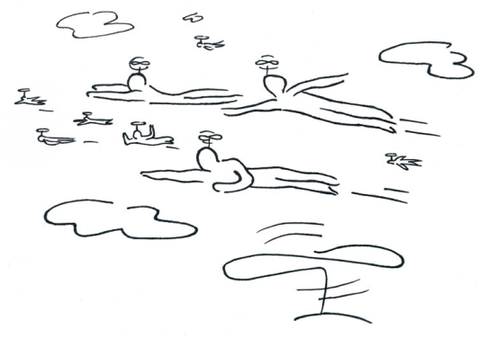
Carl Jung: Collective Subconscious
Studied under Sigmund Freud.
Believed that people from around the world shared a “Collective Unconscious”
All of the inherent knowledge humans need:
Who are we?
What is valuable and worthwhile in life?
Revealed through dream studies of many different people:
Conscious mind
Attitudes and goals very different
Unconscious minds
Remarkably similar the world over
For example, everyone dreams of flying!
Common nightmares!
Click here to watch a clip about
Common Nightmares most people report having
Jung, C G, and R F. C. Hull. The Archetypes and the Collective Unconscious. Princeton, N.J.: Princeton University Press, 1980. Print.

Slide 6
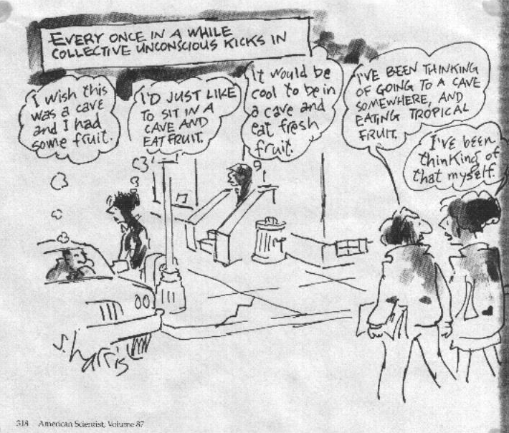
Jung: Collective Subconscious
Jung coined the term Archetype:
From the Greek archē, or beginning, and typos, or imprint meaning “the first model”
Pervasive idea or image from the collective unconscious of humankind
Universal & Primordial patterns and images
Derive from the collective unconscious
Given particular expression by individuals and their cultures.
Perceived indirectly by examining behavior, images, art, myths, religions, or dreams.
Evokes strong associations from many different people

Slide 7
So what does this have to do with English class???

Slide 8
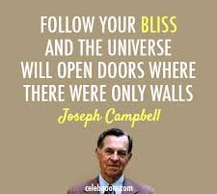
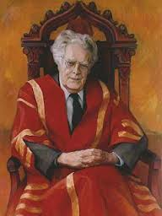
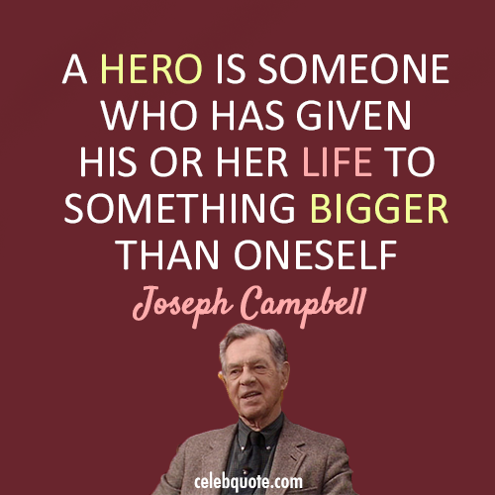
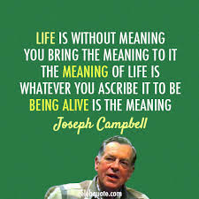
Joseph Campbell & Northrup Frye Archetypes & Literature
Campbell & Frye = Very Famous Literary Critics
Campbell, Joseph. The Hero with a Thousand Faces. Princeton, N.J.: Princeton University Press, 1968. Print.
Frye, Northrop. Anatomy of Criticism: Four Essays. Princeton: Princeton UP, 1957. Print.
***Something to think about***
Read the quotes attributed to Campbell and Frye.
In your notes/reference sheets write a brief paragraph reflecting on the quote that is most interesting to you and why (do you support, refute or qualify the ideas suggested by the quote)?
Literary Criticism?
The art or practice of judging and commenting on the qualities and character of literary works.
Types of Literary Criticism
Historical, New/Structuralist, Biographical, Feminist, Marxist, Mimetic, Deconstructionist, and many more…
The most technologically efficient machine that man has ever invented is the book. - Northrop Frye

Slide 9
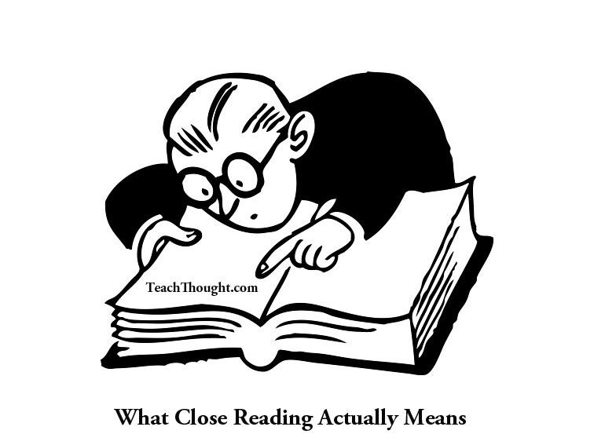
Joseph Campbell & Northrup Frye Archetypes & Literature
Campbell & Frye & You = Structural/New Criticism
Close Readings of the words of a text
Analyzes the relationship between a text’s genre and the meaning of that text
Dominant form of criticism used in English courses across the U.S.
Examples of Tools/Terms for understanding:
“Rules” of Genre
Freytag’s pyramid (plot)
Character development & themes
Use of Figurative Language & Rhetorical Devices to convey meaning
(metaphor, simile, oxymoron, foreshadowing, irony, etc.)
Function of epic heroes, archetypes, symbols & other patterns in the text

Slide 10
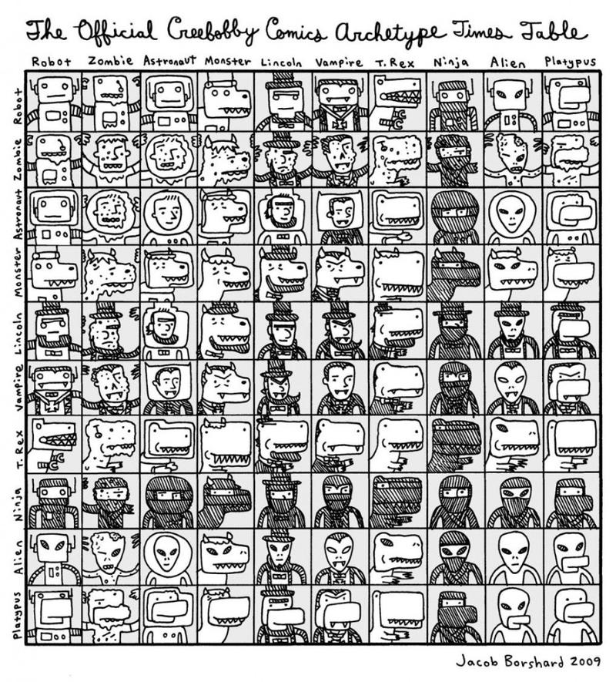
Joseph Campbell & Northrup Frye Archetypes & Literature
Campbell’s & Frye’s Specific Subdivision:
Archetypal Criticism
Understand a text’s deeper meaning by examining:
Recurring cultural and psychological myths
Repeated archetypes/patterns
in the narrative, symbols, images, situations and character types
Obvious and/or implied
Evokes strong associations to the reader or observer
Your brain doesn’t need a lot of information to understand what is going on
Think of the first 15 minutes of a action/horror/romance movie

Slide 11
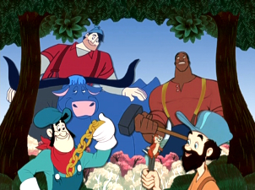
Stories from American Culture & Folklore
Let’s see if we can detect any archetypes in these 4 tales…
Remember archetypes are repeated patterns in the narrative, symbols, images, situations & character types
What traits, characteristics or features do each of the main characters have in common?
What patterns/similarities do you see in the stories?
Did you notice any differences?
List your observations and findings in a chart as you actively watch and process the clips.
Click the picture to go to video clip
Character | Character Traits | Story Details | Unique Aspects
John Henry
Johnny Appleseed
Paul Bunyan
Casey Jones, the Brave Engineer

Slide 12
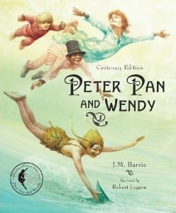
Once Upon A Time Activity
BRING IN FOR TOMORROW (10 Points)
What is your favorite fairy tale, myth, or fable? Or what was your favorite when you were little?
Find a copy of the story online to print out and bring into class on [Due Date]. If you can find a picture or two of the main characters bring those in as well. If you have a children’s’ book that includes the story and you wish to bring it in, you may do so.
If you cannot find the story to print out, write up a detailed
summary of the story on a piece of paper. You will need
this for activities we are completing next week.
For example, Ms. G’s favorite fairy tale is
Peter Pan & Wendy
(Sorry, but you must pick a different one)

Slide 13
Archetypes
Definition Review:
Primordial and Universal patterns and images
Evident in all cultural products including: LITERATURE
(also art, music, sports stories, nightly news, movies, video games, etc.)
3 types of literary archetypes
Symbol
Situational
Character
***Important Additional Information***
Archetypes are not “one size fits all”.
Archetypes are up for interpretation with support from the text
When looking for archetypes keep these questions in mind:
What archetype or pattern is this example MOST like? (i.e. Batman)
Why and how does this example differ from the typical archetype? How does this change the meaning? (i.e. Hero vs. Anti-Hero)

Slide 14
Let’s explore…
Get into groups of three.
Consider the color assigned to your group.
Collaborate with your group to determine at least 2 things that your color can represent and examples or reasons why.
Possibilities:
Red, Orange, Yellow, Green, Blue, Purple, Brown, Black, White, Silver, Gold

Slide 15
Symbolic Archetypes
Certain images, symbols or settings that recur in myths and other genres of literature often have a common meaning or tend to elicit comparable psychological responses and to serve similar cultural functions.
1. Light vs. Darkness
2. Water vs. Desert
3. Heaven vs. Hell
4. Haven vs. Wilderness
5. Supernatural Intervention
6. Fire vs. Ice
7. Colors
8. Numbers
9. Shapes

Slide 16
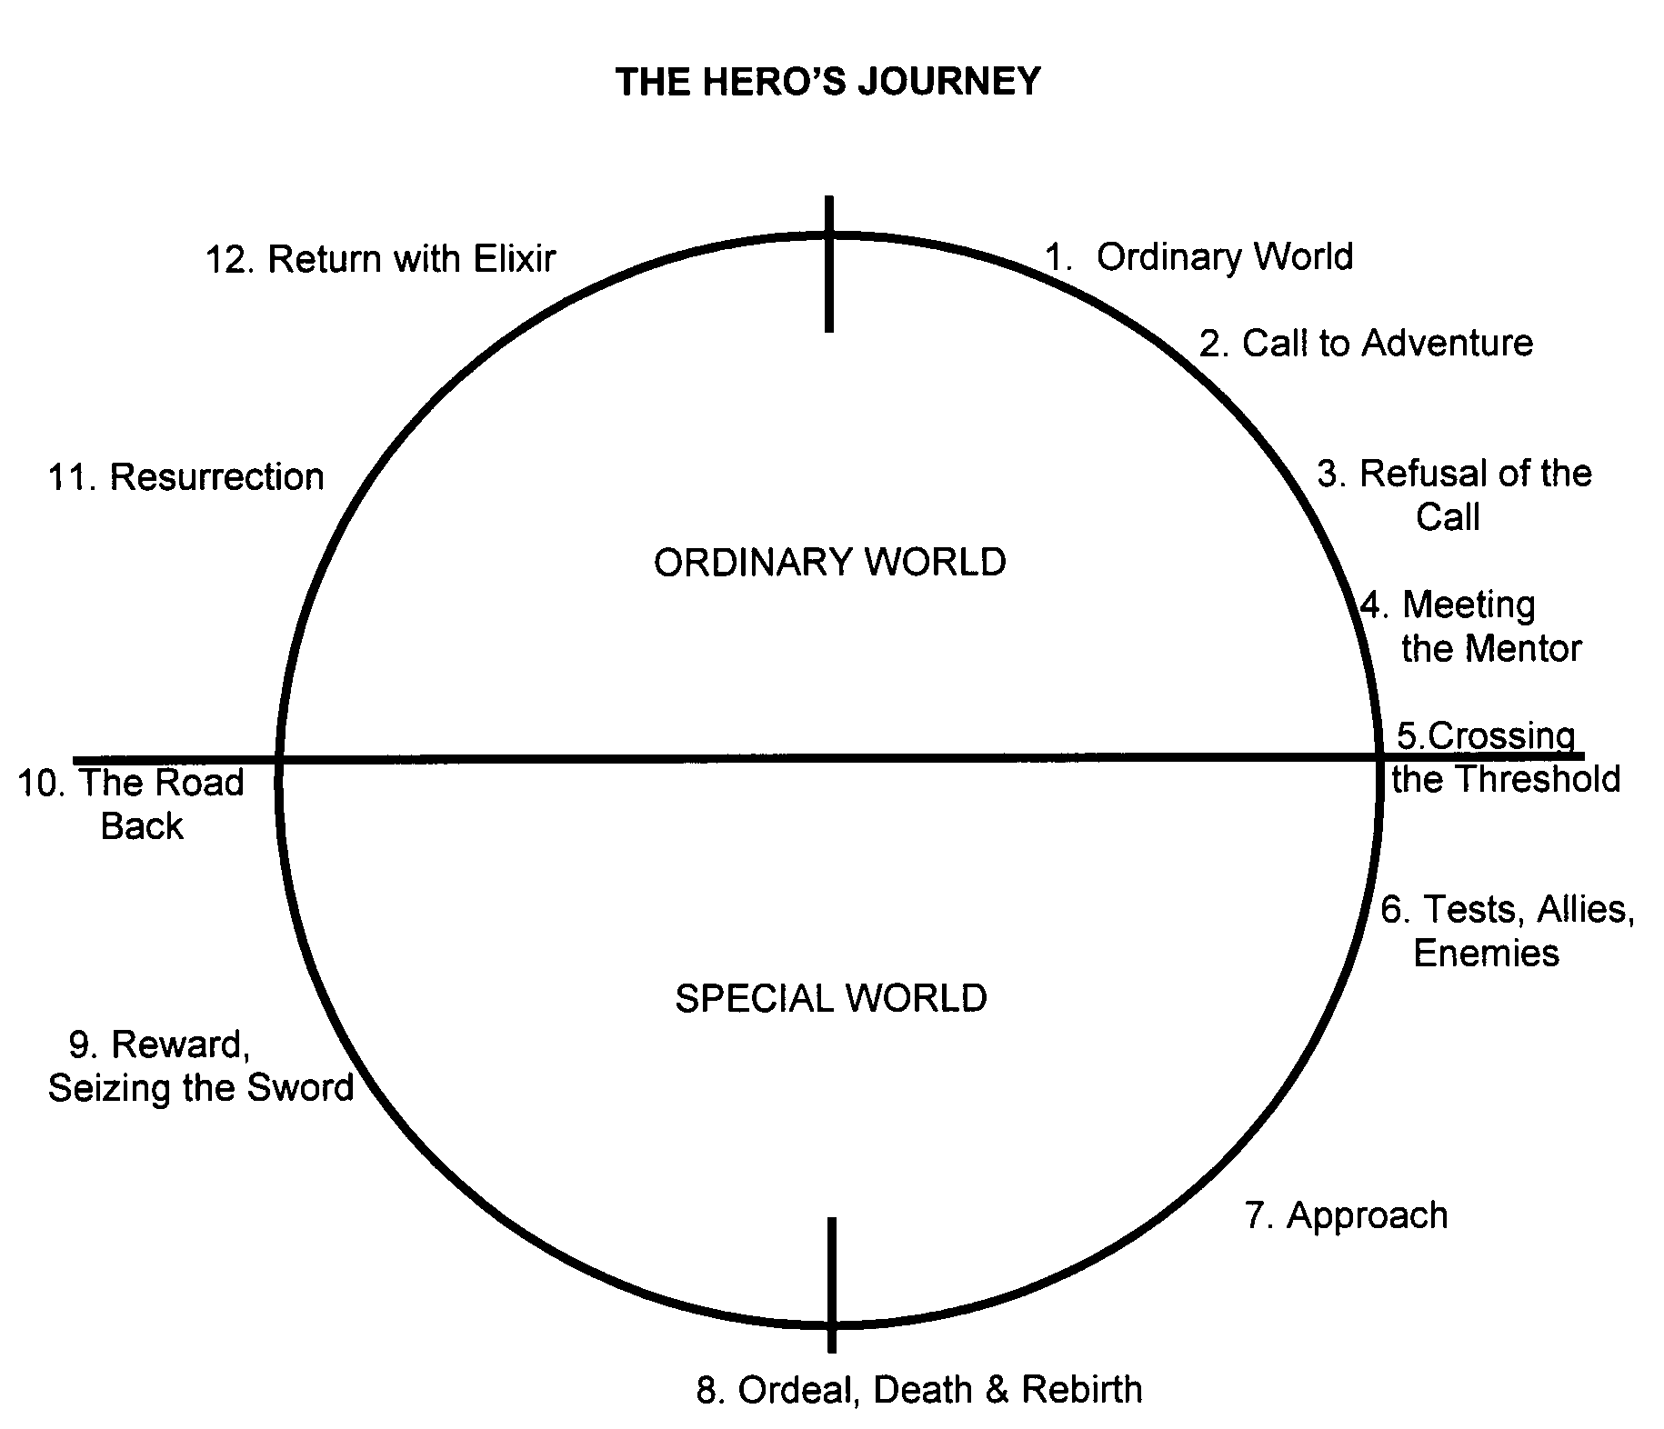
Situational Archetypes
Circumstances that occur repeatedly in literature, art, movies, music, video games, and stories of all kinds.
Almost every story is based on a version of the archetypal hero’s quest and contains other situational archetypes, as well.
Joseph Campbell called this “The Hero’s Journey”

Slide 17
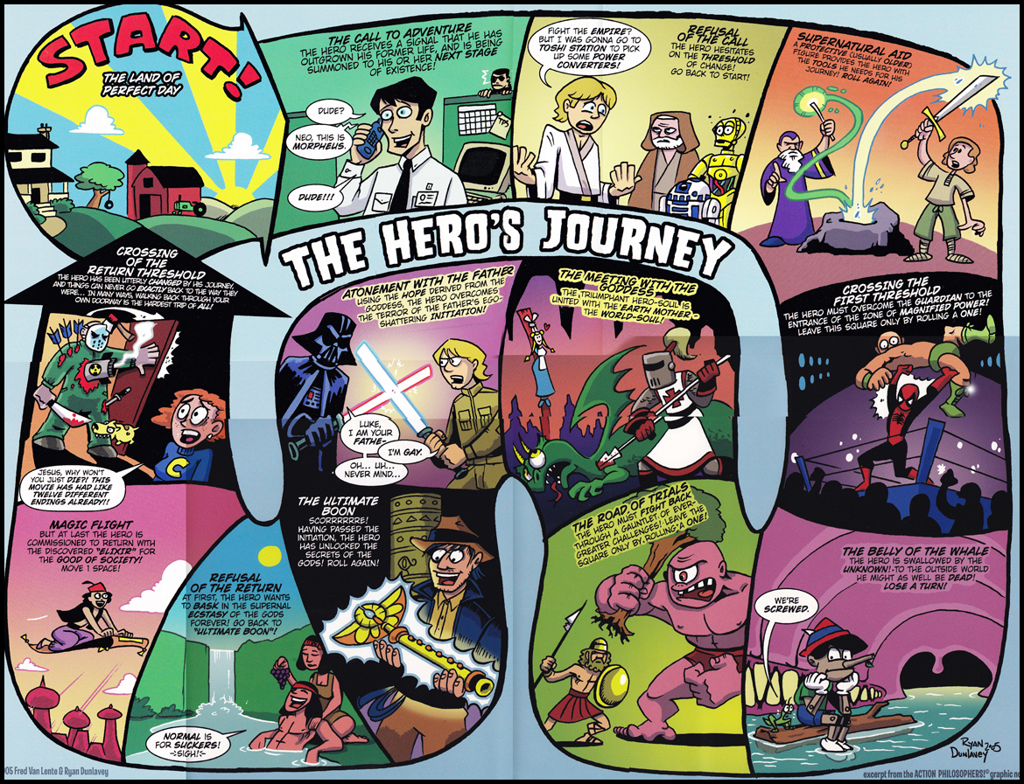
Don’t take my word for it…
Let’s watch a video that will give you a better understanding of The Hero’s Journey

Slide 18
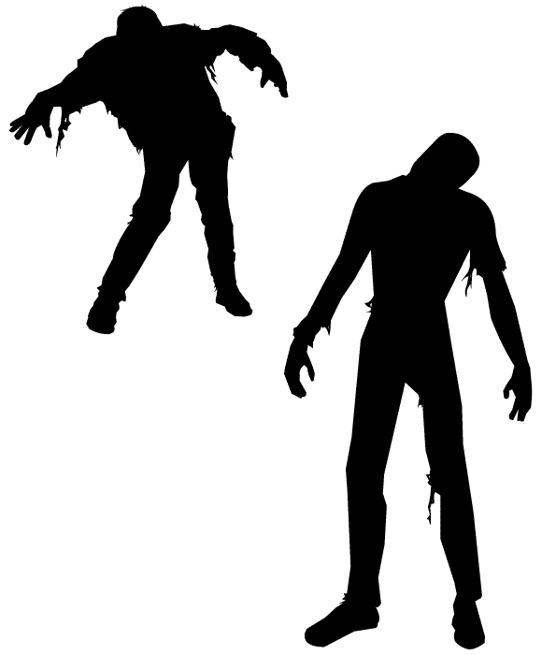
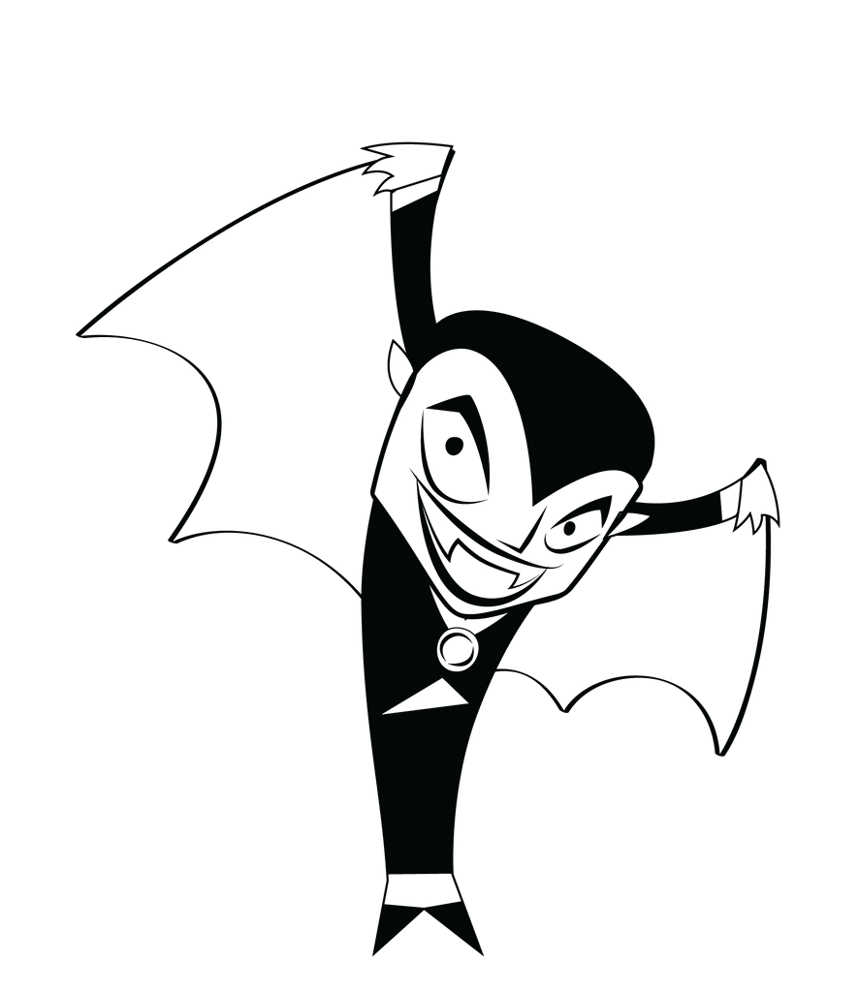
Character Archetypes
A character who appears over and over in stories far and wide, even in cultures that have shut themselves off from the world.
For example:
The blood-drinking, risen “undead” are an archetype as almost every culture has come up with their own legends independent of each other. We call this character a _____________ or a ______________?
PONTIANAK (INDONESIA)
GJENGANGER (NORWAY)
VETALA (INDIA)
GHOUL (ARABIA)

Slide 19
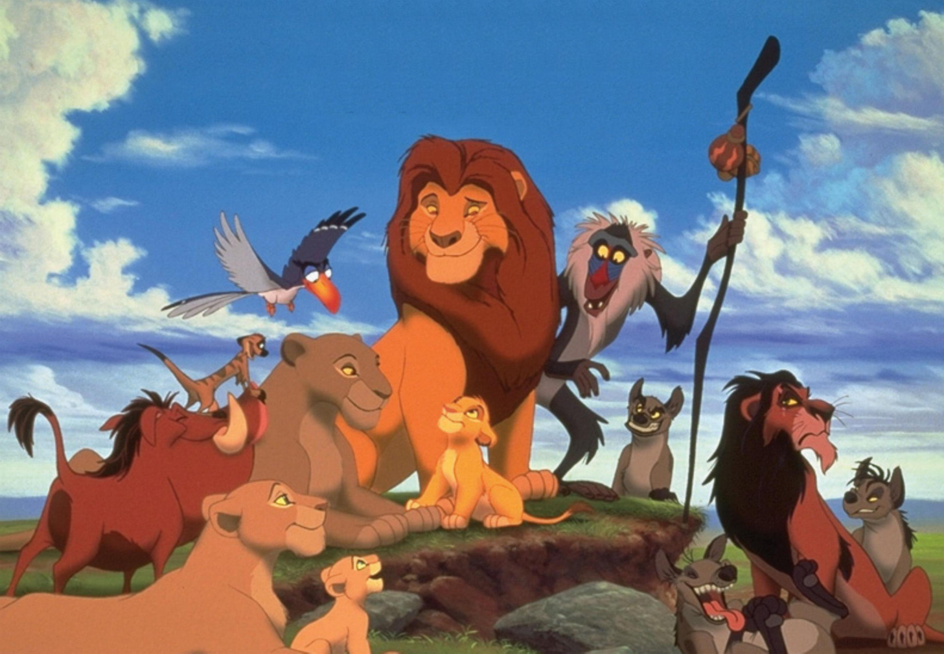
Character Archetypes
Some lit-theories classify archetypes by first by the role/purpose the character inhabits for the story before categorizing them by countless other categories of archetypes. These primary categories are:
Protagonist
Antagonist
Voice of Reason
Emotion-Driven Character
Sidekick
Skeptic
Guardian

Slide 20
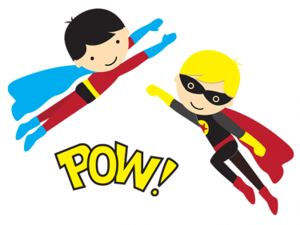
The “Hero” Archetype
Arguably the most common archetype found around the world – why?
Do we still need heroes?
How do we recognize who and what are heroes are today?
Different types of hero:
Epic
Tragic
Romantic
Anti-hero
http://ed.ted.com/lessons/a-host-of-heroes-april-gudenrath

Slide 21
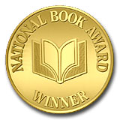
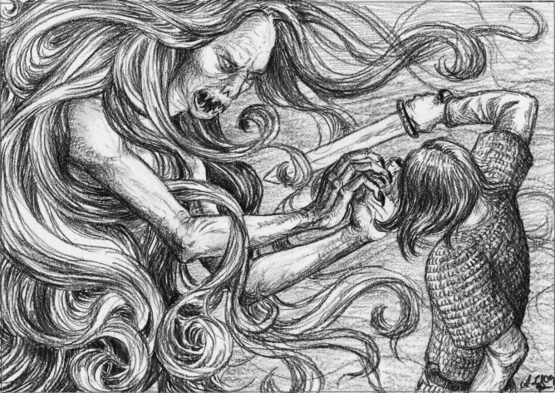
Further Exploration
Focusing specifically on “The Hero” and “The Hero’s Journey” archetypes
Self-Selected Novel
Fiction
# of pages
Must have a central hero and some sort of quest story
Consider Black Eyed Susan Nominees
Look for award-winning books
Check online lists of “books every high school students should read” or “books you should read before college”
No student may read the same book
Every book choice must be approved by the teacher before check-out
Comparing and analyzing Ancient & British Literature with Structural/Archetypal Criticism
Gilgamesh
Beowulf
Canterbury Tales
Other various cultural products along the way!

Slide 22
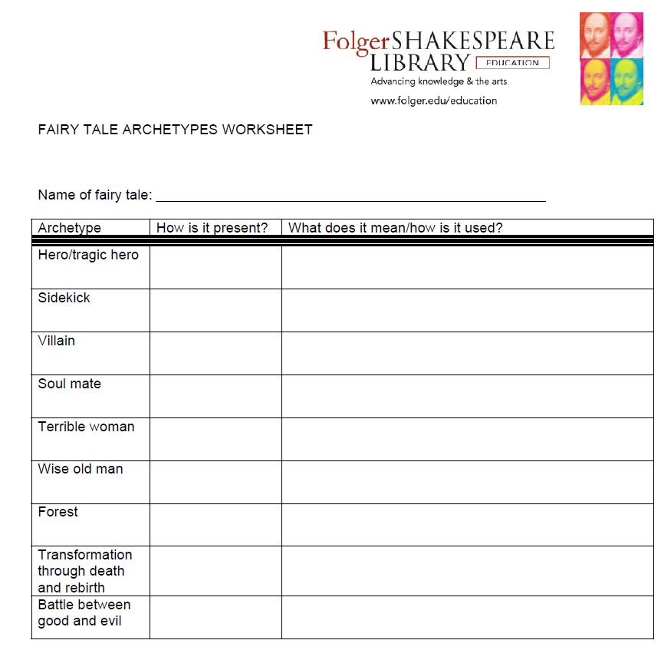
Once Upon A Time Activity
As a class, let’s use J.M. Barrie’s Peter Pan and Wendy to complete an activity where we use archetypal analysis to better understand a story

Slide 23
Fairytale Name: Peter Pan
Archetype | How is it present? | What does is mean? How is it used?
Hero/Tragic Hero | Peter Pan | Peter represents eternal youth, staying young forever, He is not a perfect hero because he does not want to grow up & be responsible. He represents the positive “inner child” in all of us!
Sidekick | The Lost Boys | These are other children Peter has recruited through time to join him in staying young forever. Like Peter, they mean well but don’t realize that their games can hurt people. They are blindly loyal to Peter and follow his orders. Unlike Peter, they sometimes recall their former lives in the “real” world; they can also be moved to admit missing their mothers.
Villain | Captain Hook | He is a mirror reflection of Peter. He’s a grown adult who acts like a selfish child. He is a bad-tempered bully, a cheater, and a coward. He also represents what Peter could become if he refuses to grow up. He plays games with Peter and the Lost Boys, but he intends to capture and kill them all the first chance he gets.
Soul Mate | Wendy Darling | Wendy loves being the oldest, and cares for her brothers the way a mother would in Neverland. Wendy reminds all the Lost Boys of how much they miss their real mothers. She is very fond of Peter, but she questions him and will not always do what he says. Wendy also wants him to act more responsibly and take her home (which is new and exciting to Peter).

Slide 24
Terrible Woman | Tigerlily The Mermaids Tinkerbell | All these girls are NOT big fans of Wendy Darling. They want to keep Peter in Neverland and keep him interested in them. In some versions of the story all of them try to kill Wendy or one of the other Darling children at some point in the story.
Wise Old Man | The Darling Children Smee | Both Wendy and Michael fight the urge at first to join in on all the reckless shenanigans Neverland has to offer. Even John in the end decides he has had enough and he wants to go home, their wisdom: real life is better than fantasy. Smee is the only voice of reason Hook has. He is often trying to warn him about fighting Peter and tries to get Hook to agree to leave Neverland.
Forest (Wilderness) | Neverland | Magical, Mystical place with Jungles, Pirates Coves, Caves and all sorts of places that are FANTASTIC and WILD in nature
Transformation through Death and Rebirth | Hook destroys the Lost Boys hideout, so they must battle Hook. Peter takes command of the Pirate Ship to take the Darlings back home | Death: Hook, the Hideout, Peter’s selfishness Rebirth: Peter is reborn as a more selfless leader, The Darlings are reborn into their lives as children in the real world. In some versions of the story Peter decides to grow up There is also the death and resurrection of the fairy Tinkerbell which some interpret as the readers being asked to honor and revive their inner children (clap if you believe)
Battle between Good and Evil | Childhood Innocence vs. Adult selfishness | All of the children represent the various ways real children come to terms with the end of childhood and trying to be more responsible adults while trying to hang on to the magic of childhood. Hook represents an evil perversion of what happens when an adult refuses to let go of childish ideas and selfish ways

Slide 25
Once Upon A Time Activity
Now it’s your turn – Using the story you brought in from home complete the same worksheet (printed again on the back)
REMEMBER
Archetypes are not “one size fits all”.
Archetypes are up for interpretation with support from the text.
When looking for archetypes keep these questions in mind:
What archetype or pattern is this example MOST like? (i.e. Batman)
Why and how does this example differ from the typical archetype? Does this change the meaning? (i.e. Hero vs. Anti-Hero)
***If you absolutely cannot find a match with your story and the archetypes listed, use your handouts and notes from previous lessons to come up with a substitution that works. ***

Slide 26
What you’ve learned so far…
Look for notes/handouts about these concepts in your binders:
Freud’s Theory of Personality
Jung’s concept of “collective subconscious”
Literary Criticism
Specifically Structural/Archetypal (Campbell/Frye)
Archetypes
Symbolic Archetypes
Situational Archetypes
The Hero’s Journey
Character Archetypes
The Hero

